Slide 1
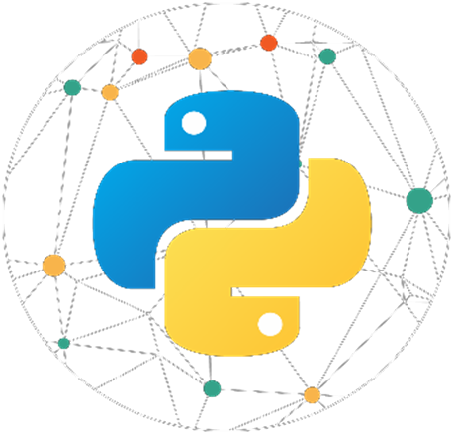
1. 2 P Y T H O N E X P E R T C O U R S E T O U R
s
S r i r a m - I T E x p e r t
Y o u t u b e C h a n n e l : I n t e l l e c t S r i r a m

Slide 2
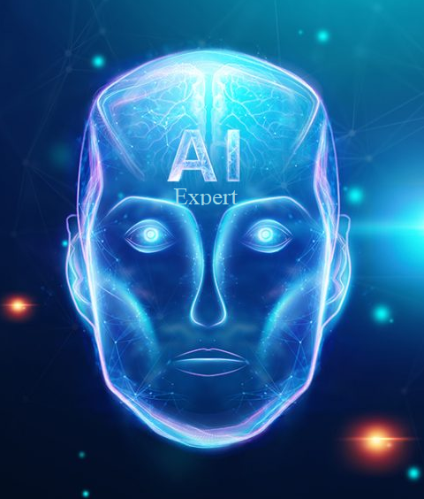
Python Programming Topics
Python Expert Course Tour
1. Python 101
2. Python Basics
3. Flow Control
4. Data Structures in Python
5. Functions, Modules and Packages
6. String Handling
7. File Handling
8. Errors and Exception Handling
9. OOPS Concepts
10 Python Numpy
11. Python Pandas
12. Python Matplotlib
13. Python SciPy
14. Python Seaborn
15. Database Programming
16. Interprocess Communication
17. Network Programming
18. Web Python
19. GUI Programming
20. Design Patterns

Slide 3
Python Certifications

Slide 4
Python Certification – PCAP & PCPP 1 & 2
Python Expert Course Tour
PCAP - Certified Associate in Python Programming
https://pythoninstitute.org/certification/pcap-certification-associate/pcap-exam-syllabus/
PCPP 1- Certified professional in Python Programming 1
https://pythoninstitute.org/certification/pcpp-certification-professional/pcpp-32-1-exam-syllabus/
PCPP 1- Certified professional in Python Programming 2
https://pythoninstitute.org/certification/pcpp-certification-professional/pcpp-32-2-exam-syllabus
Visit Pearson Vue
https://home.pearsonvue.com/python

Slide 5
Certified Expert in Python Programming
Python Expert Course Tour
Test candidates who complete the OpenEDG Python Institute Programming Certification path available in cooperation with Pearson VUE, i.e., those candidates who pass the following exams: PCAP-31-xx, PCPP1-32-1xx, and PCPP2-32-2xx, become recognized as OpenEDG Python Institute Certified Experts in Python Programming (CEPP).
Individuals holding the CEPP title are recognized for their expert Python programming skills as well as their proficiency in Python-related technologies.

Slide 6
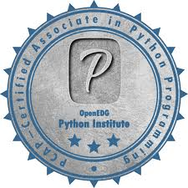
PCAP

Slide 7
PCAP – Certified Associate in Python Programming
Python Expert Course Tour
PCAP certification is a professional credential that measures your ability to accomplish coding tasks related to the basics of programming in the Python language and the fundamental notions and techniques used in object-oriented programming.
Exam Level: Associate
Prerequisites: None
Current Exam Version: PCAP-31-02 (retiring), PCAP-31-03
Exam Length: 65 minutes (exam) + 10 minutes (NDA/Tutorial)
Number of Exam Items: 40
Passing Score: 70%
Exam Status: Published in 2019

Slide 8
PCAP – Exam Syllabus – Block #1
Python Expert Course Tour
Modules and Packages (12%)
Objectives covered by the block (6 items)
import variants; advanced qualifying for nested modules
dir(); sys.path variable
math: ceil(), floor(), trunc(), factorial(), hypot(), sqrt(); random: random(), seed(), choice(), sample()
platform: platform(), machine(), processor(), system(), version(), python_implementation(), python_version_tuple()
idea, __pycache__, __name__, public variables, __init__.py
searching for modules/packages; nested packages vs directory tree

Slide 9
PCAP – Exam Syllabus - Block #2
Python Expert Course Tour
Exceptions (14%)
Objectives covered by the block (5 items)
except, except:-except; except:-else:, except (e1,e2) the hierarchy of exceptions
raise, raise ex, assert
event classes, except E as e, arg property
self-defined exceptions, defining and using

Slide 10
PCAP – Exam Syllabus – Block #3
Python Expert Course Tour
Strings (18%)
Objectives covered by the block (8 items)
ASCII, UNICODE, UTF-8, codepoints, escape sequences
ord(), chr(), literals
indexing, slicing, immutability
iterating through,
concatenating, multiplying, comparing (against strings and numbers)
in, not in
.isxxx(), .join(), .split()
.sort(), sorted(), .index(), .find(), .rfind()

Slide 11
PCAP – Exam Syllabus – Block #4
Python Expert Course Tour
Object-Oriented Programming (34%)
Objectives covered by the block (12 items)
ideas: class, object, property, method, encapsulation, inheritance, grammar vs class, superclass, subclass
instance vs class variables: declaring, initializing
__dict__ property (objects vs classes)
private components (instance vs classes), name mangling
methods: declaring, using, self parameter
instrospection: hasattr() (objects vs classes), __name__, __module__, __bases__ properties
inheritance: single, multiple, isinstance(), overriding, not is and is operators
inheritance: single, multiple, isinstance(), overriding, not is and is operators
constructors: declaring and invoking
polymorphism
__name__, __module__, __bases__ properties, __str__() method
multiple inheritance, diamonds

Slide 12
PCAP – Exam Syllabus – Block #5
Python Expert Course Tour
Miscellaneous (List Comprehensions, Lambdas, Closures, and I/O Operations) (22%)
Objectives covered by the block (4 items)
list comprehension: if operator, using list comprehensions
lambdas: defining and using lambdas, self-defined functions taking lambda as as arguments; map(), filter();
closures: meaning, defining, and using closures
I/O Operations: I/O modes, predefined streams, handles; text/binary modes open(), errno and its values; close() .read(), .write(), .readline(); readlines() (along with bytearray())

Slide 13
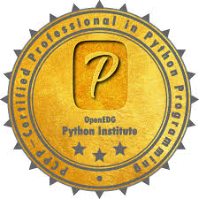
PCPP 1

Slide 14
PCPP – Certified Professional in Python Programming
Python Expert Course Tour
PCPP – Certified Professional in Python Programming certifications (PCPP-32-1xx and PCPP-32-2xx) are professional credentials that measure your ability to accomplish coding tasks related to advanced programming in the Python language and related technologies, advanced notions and techniques used in object-oriented programming, selected library modules (file processing, communicating with a program’s environment; mathematics-, science-, and engineering-oriented modules), GUI programming, network programming, as well as creating tools, frameworks and complete systems.

Slide 15
PCPP1 – Certified Professional in Python Programming 1
Python Expert Course Tour
PCPP1 certification shows that the individual is proficient in the more advanced language features and familiar with the best practices in Python. The scope of certification includes an advanced study of classes and OOP, GUI programming, RESTful programming, file processing, testing, code refactoring, as well as best practices, standardization, and coding conventions in the Python language.
Exam Level: Professional Level 1
Prerequisites: PCAP – Certified Associate in Python Programming certification
Current Exam Version: PCPP1-32-101 (coming late October 2020)
Exam Length: 65 minutes (exam) + 10 minutes (NDA/Tutorial)
Number of Exam Items: 40
Passing Score: 70%
Exam Status: Publishing in 2021

Slide 16
PCPP 1 – Exam Syllabus –– Block #1
Python Expert Course Tour
File Processing and Communicating with a Program’s Environment (20%)
Objectives covered by the block (8 exam items)
Processing different kinds of files
sqlite3 – interacting with SQLite databases
xml – creating and processing XML files
csv – CSV file reading and writing
logging – basics logging facility for Python
configparser – configuration file parser
Communicating with a program’s environment:
os – interacting with the operating system,
datetime – manipulating with dates and time
io – working with streams,
time – time access and conversions

Slide 17
PCPP 1 – Exam Syllabus –– Block #2
Python Expert Course Tour
Math, Science, and Engineering Tools (20%)
Objectives covered by the block (8 exam items)
math – a basic tool for elementary evaluations
NumPy – fundamental package for scientific computing
SciPy – an ecosystem for mathematics, science, and engineering
Matplotlib – 2D plotting library producing publication quality figures
Pandas – a library providing high-performance and data analysis tools
Scikit-image – a collection of algorithms for image processing

Slide 18
PCPP 1 – Exam Syllabus –– Block #3
Python Expert Course Tour
GUI Programming (20%)
Objectives covered by the block (8 exam items)
What is GUI and where it comes from
Constructing a GUI – basic blocks and conventions
Event-driven programming
Currently used GUI environments and toolkits
tkinter — Python interface to Tcl/Tk
tkinter’s application life cycle
Widgets, windows and events
Sample applications
pygame – a simple way of developing multimedia applications

Slide 19
PCPP 1 – Exam Syllabus –– Block #4
Python Expert Course Tour
Python Enhancement Proposals (15%)
Objectives covered by the block (6 exam items)
What is PEP?
Coding conventions – not only style and naming
PEP 20 – The Zen of Python: a collection of principles that influences the design of Python code
PEP 8 – Style Guide for Python Code: coding conventions for code comprising the standard library in the main Python distribution
PEP 257 – Docstring Conventions: what is docstring and some semantics as well as conventions associated with them
A tour of important PEPs

Slide 20
PCPP 1 – Exam Syllabus –– Block #5
Python Expert Course Tour
Advanced Perspective of Classes and Object-Oriented Programming in Python (25%)
Objectives covered by the block (10 exam items)
Classes, Instances, Attributes, Methods
Working with class and instance data
Copying object data using shallow and deep operations
Inheritance and Polymorphism
Different faces of Python methods: static and class methods
Abstract classes vs. method overloading
Composition vs. Inheritance – two ways to the same destination
Implementing Core Syntax
Subclassing built-ins

Slide 21
PCPP 1 – Exam Syllabus –– Block #5..
Python Expert Course Tour
Attribute Encapsulation
Advanced techniques of creating and serving exceptions
Serialization of Python objects using the pickle module
Making Python object persistent using the shelve module
Metaprograming
Function decorators
Class decorators
Metaclasses

Slide 22
PCPP 2

Slide 23
PCPP 2 – Certified Professional in Python Programming 2
Python Expert Course Tour
PCPP2 certification shows that the individual is fully acquainted with all the advanced techniques provided by Python and related technologies, as well as being proficient in creating Python and Python-related tools, and designing process automation. The scope of certification includes Design Patterns, Inter-Process Communication (IPC), Python-MySQL Database Access, network programming, and working with selected mathematics-, science-, and engineering-oriented library modules.
Exam Level: Professional Level 2
Prerequisites: PCAP – Certified Associate in Python Programming certification
Current Exam Version: PCPP1-32-201 (coming 2021)
Exam Length: 65 minutes (exam) + 10 minutes (NDA/Tutorial)
Number of Exam Items: 40
Passing Score: 70% Exam Status: Publishing in 2021

Slide 24
PCPP 2 – Exam Syllabus –– Block #1
Python Expert Course Tour
Creating and Distributing Packages (20%)
Objectives covered by the block (8 exam items)
Using pip
Basic directory structure
The setup.py file
Sharing, storing, and installing packages
Documentation
License
Testing principles and techniques
unittest – Unit testing framework
Pytest – framework to write tests

Slide 25
PCPP 2 – Exam Syllabus –– Block #2
Python Expert Course Tour
Design Patterns (20%)
Objectives covered by the block (8 exam items)
Object-oriented design principles and the concept of design patterns
The Singleton Design Pattern
The Factory Pattern
The Façade Pattern
The Proxy Pattern
The Observer Pattern
The Command Pattern
The Template Method Pattern
Model-View-Controller
The State Design Pattern

Slide 26
PCPP 2 – Exam Syllabus –– Block #3
Python Expert Course Tour
Interprocess Communication (20%)
Objectives covered by the block (8 exam items)
multiprocessing — Process-based parallelism
threading — Thread-based parallelism
subprocess — Subprocess management
Multiprocess synchronisation
queue — A synchronized queue class
socket — Low-level networking interface
mmap — Memory-mapped file support

Slide 27
PCPP 2 – Exam Syllabus –– Block #4
Python Expert Course Tour
Python Network Programming (20%)
Objectives covered by the block (8 exam items)
Python Socket Module
Introduction to sockets
Server Socket Methods
Client socket methods
General socket methods
Client-Server vs. Peer-to-peer
Other Internet nodules

Slide 28
PCPP 2 – Exam Syllabus –– Block #5
Python Expert Course Tour
Python-MySQL Database Access (20%)
Objectives covered by the block (8 exam items)
Relational databases – fundamental principles and how to work with them
MySQL vs. rest of the world
CRUD Application
db connection
db create
db insert
db read
db update
db delete

Slide 29
Python Tools

Slide 30


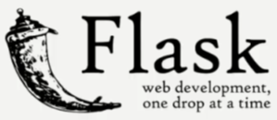
Python Tools
Python Expert Course Tour
Python Libraries
Web Framework
Desktop Tools

Slide 31
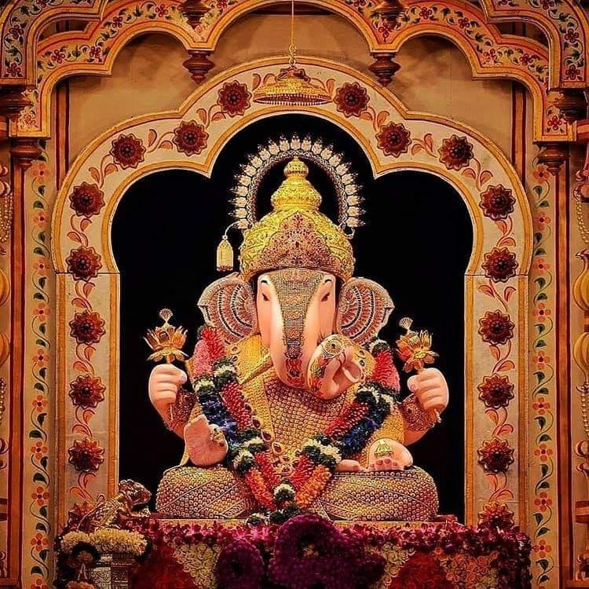

T h a n k Y o u !
I n t e l l e c t S r i r a m
Subscribed
LinkedIn : https://www.linkedin.com/in/sriram-balasubramanian-374566166/
GitHub : https://github.com/intellectsriram

